Slide 1
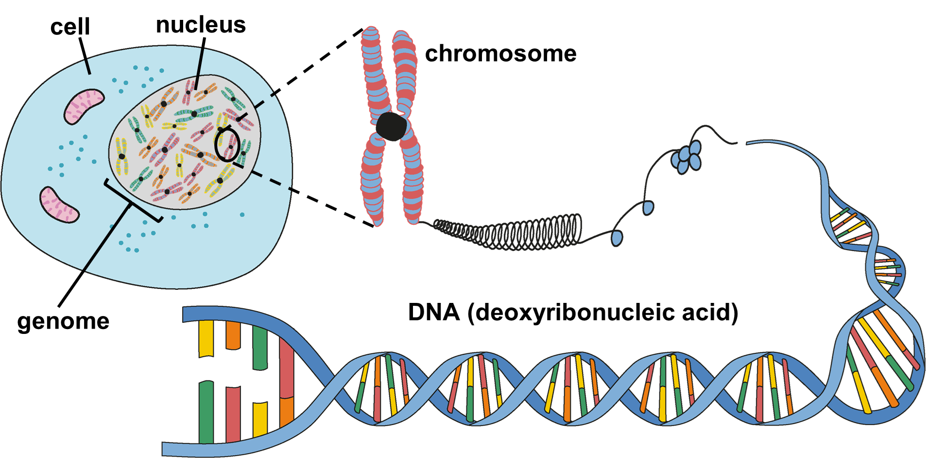
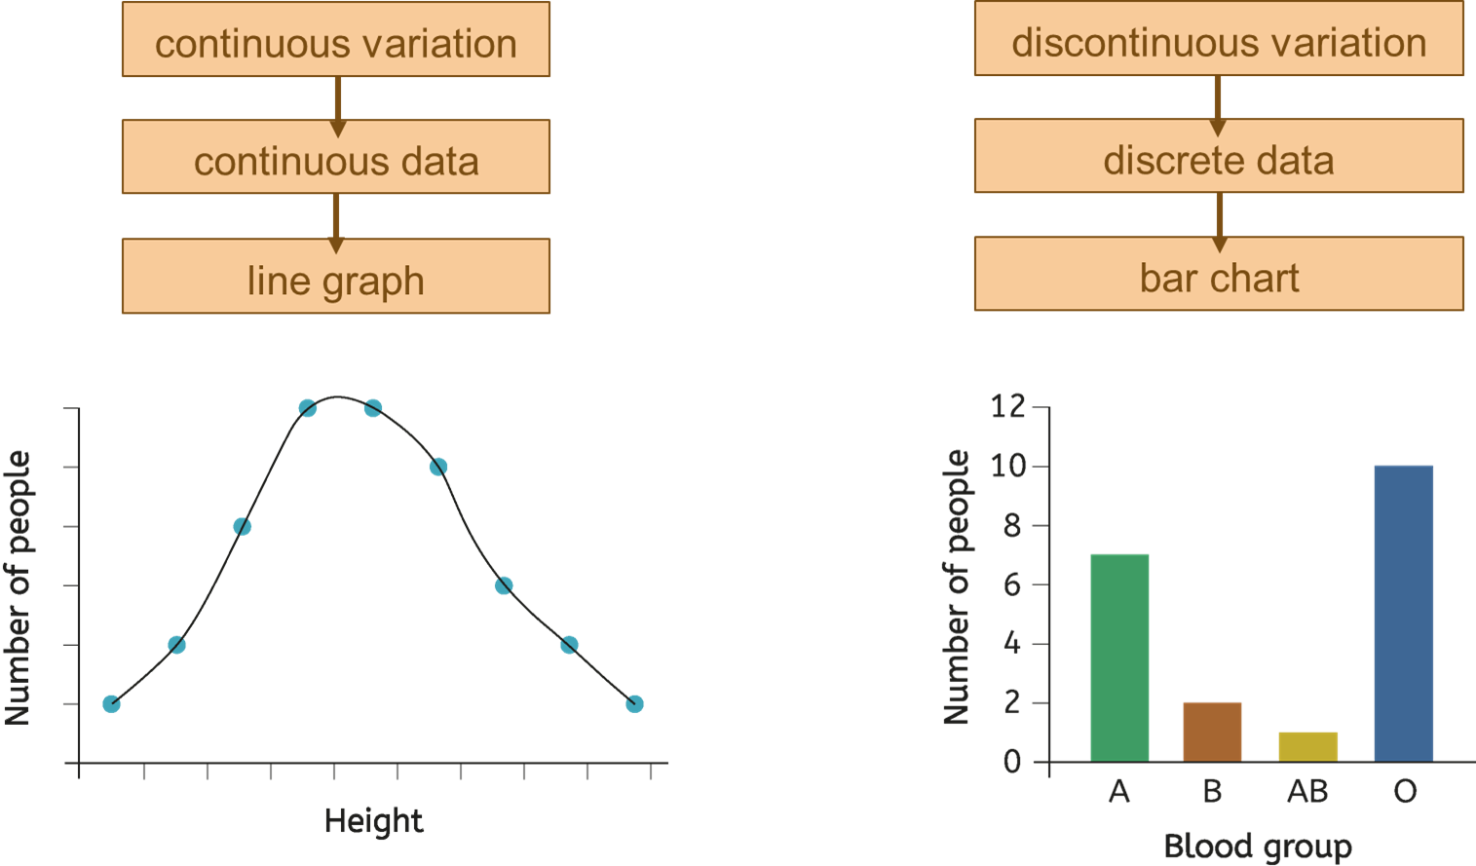
Life Cycles
Reproduction is the process of making new living organisms known as offspring, which happens at some point in an organism’s life cycle.
Offspring inherit characteristics from both parents through their genomes, which contain the complete set of genetic information.
Offspring usually look similar but not identical to their parents because they inherit half of their genome from each parent.
Variation
A species is a group of organisms that can reproduce with each other to produce offspring that are fertile.
Variation is the differences between organisms of the same species.
Genetic variation is caused by an offspring’s inherited genome.
Environmental variation is caused by an organism’s environment
or by an organism’s lifestyle.
Variation within a species is important for adaptation and survival.
Discontinuous variation is variation that that can be classified into specific categories (e.g. eye colour, blood type, rolling tongue, shoe size).
Continuous variation is variation that can have a range of values (e.g. body mass, plant height, hand span, foot length).
Discontinuous variation tends to be determined by a single gene or just a few genes. Continuous variation tends to be determined by many genes and the environment.
Data on continuous and discontinuous variation can be classified as quantitative, including discrete (whole numbers, counted) and continuous (measured values), or qualitative, which consists of categoric data (descriptive labels).
Genome, Chromosomes, DNA and Genes
The genome is made of a chemical substance called DNA.
DNA is a natural polymer and has two strands that are connected across the middle and twisted to form a double helix structure.
DNA is coiled into structures called chromosomes, which are stored in the nucleus in plant and animal cells.
Different organisms have different numbers of chromosomes.
Human body cells each contain 23 pairs of chromosomes, half of which are from each parent.
Each chromosome is divided into sections of DNA called genes.
The hierarchy in size order from smallest to largest is:
gene → DNA → chromosomes → genome.
All the DNA in a cell, packed into chromosomes and made up of genes, together forms the cell's genome.
Scientific methods led to the discovery of DNA's structure in the 1950s. Rosalind Franklin's X-ray images revealed its spiral form, which helped Watson and Crick determine the double helix structure
Science | 7.08 – Life cycles | Knowledge Organiser
Notes:
Images:
All images – United Learning

Slide 2
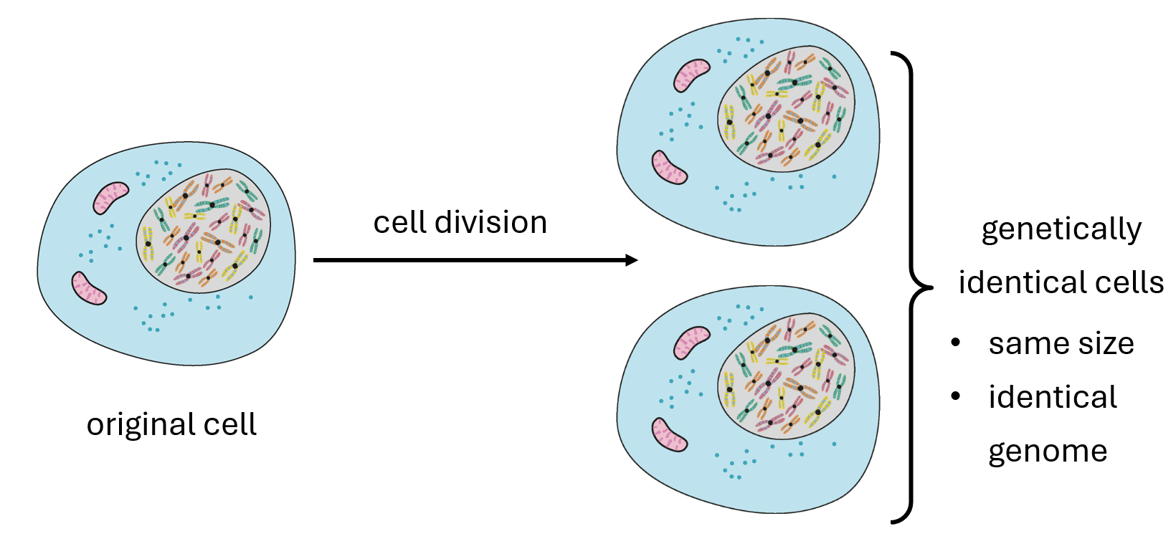
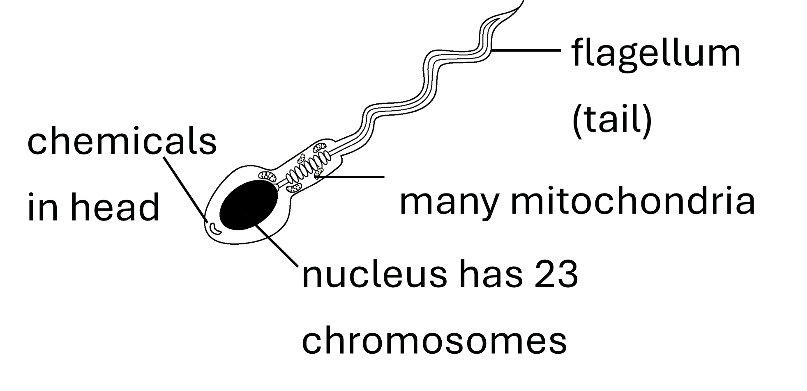
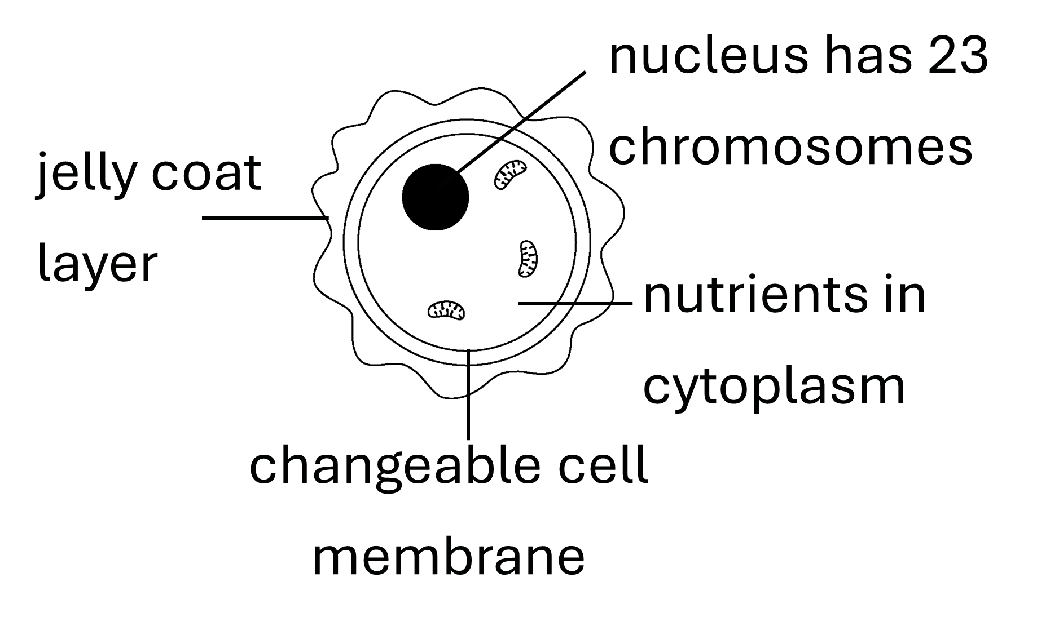
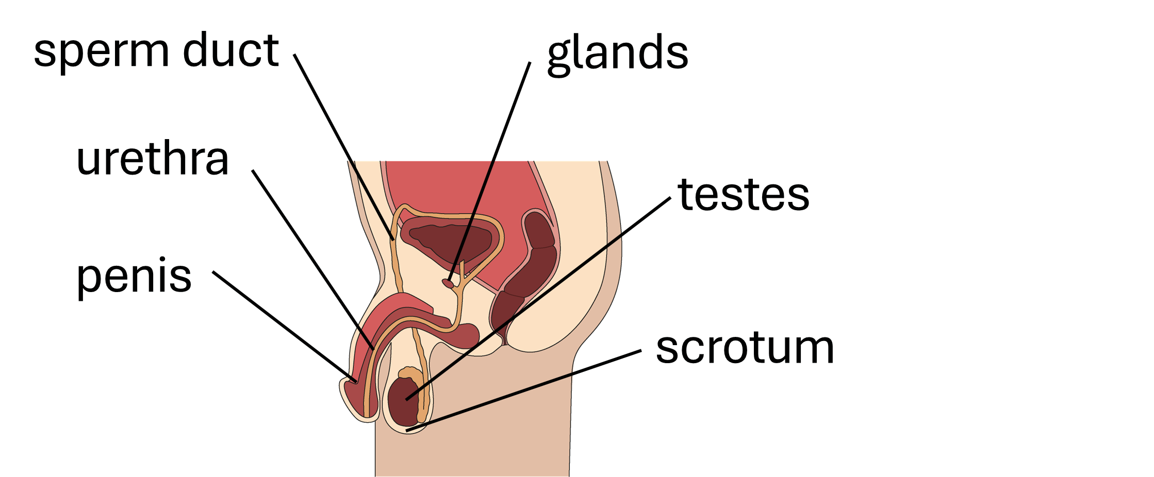
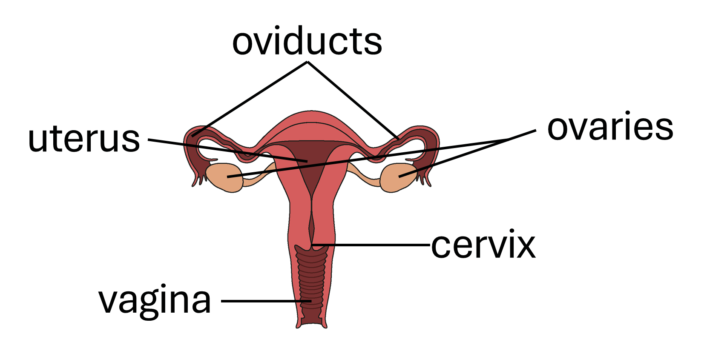
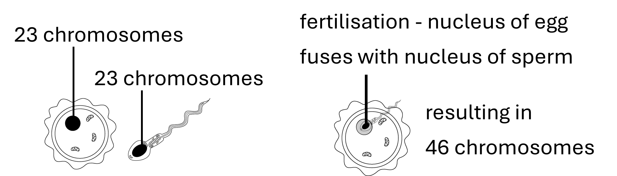
Life Cycles
Growth and Development
Gamete Adaptations (Egg and Sperm)
In multicellular organisms, growth is when an organism increases the number of cells it has. When multicellular organisms grow,
new cells are made from existing cells by:
cell enlargement – the cell gets bigger.
cell division – the cell divides to form two genetically identical cells.
As an organism develops, specialised cells are created to carry out specific functions.
Male and Female Reproductive Systems
Sexual Reproduction and Fertilisation in Humans
testes – make sperm
scrotum - holds the testes at the right temperature
sperm duct – carries sperm from the testes
glands – produce fluid that mises with the sperm
urethra – carries semen (and urine)
penis - where semen (containing sperm) leaves the body
ovaries - release eggs
oviducts - carry the egg from the ovaries to the uterus
uterus - where the baby develops
vagina - sperms enters and the baby is pushed out
cervix – ring of muscle that keeps the baby in place
Technological advances like digital microscopes allow scientists to capture high-resolution images and videos of eggs, sperm, and the zygote during cell division.
Fertilisation happens if the egg cell meets and joins with a sperm cell in the oviduct. The fertilised egg (zygote) attaches to the lining of the uterus (implantation).
The sperm and egg each contain 23 single chromosomes.
The fertilised egg (zygote) has 23 pairs of chromosomes.
  During fertilisation, the genomes of both parents combine. This creates genetic variation.
Science | 7.08 – Life cycles | Knowledge Organiser
Notes:
Images:
All images – United Learning

Slide 3
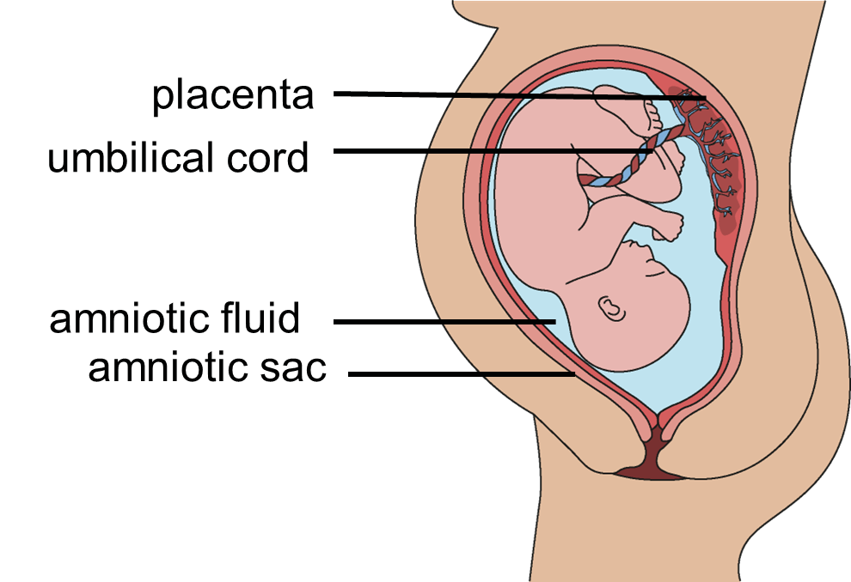
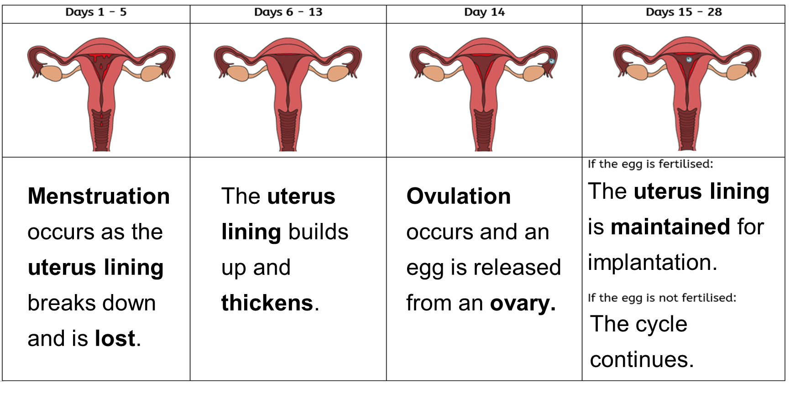
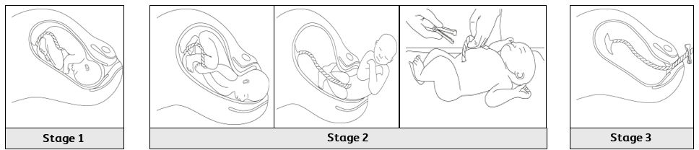
Life Cycles
Puberty and the Menstrual Cycle
Pregnancy and Foetal Development
Adolescence is a period of emotional and physical changes known as puberty.
Puberty affects both males and females, with some changes specific to each sex.
Both males and females experience changes such as underarm and pubic hair growth, increased body odour, emotional changes, and a faster growth rate.
Males also go through voice deepening, enlargement of the testes and penis, sperm cell production, shoulder and chest widening, and facial and chest hair growth.
Females develop breasts, start ovulating and having menstrual cycles, and experience hip widening.
Fertilisation → Zygote → Embryo → Foetus → Baby → Birth
A foetus develops in the uterus.
The foetus relies on its mother for:
  protection against bumps
  and temperature changes;
  oxygen for respiration;
  nutrients (food and water).
The foetus also needs its
waste substances to be removed.
The foetus is protected by
the uterus and the amniotic fluid,
contained in the amniotic sac.
The placenta provides oxygen and
nutrients, and removes waste
(e.g. carbon dioxide) by diffusion of these substances
between the mother’s blood and the foetus’ blood.
The umbilical cord joins the placenta to the foetus and transfers substances between the two.
Substances like alcohol, cigarette chemicals, and drugs can cross the placenta by diffusion, affecting the developing baby.
The menstrual cycle is an approximately 28-day, hormone regulated process that prepares the female body for pregnancy, although some women may have cycles ranging from 21 to 35 days. The menstrual cycle begins at puberty, stops during pregnancy, and ceases completely after menopause, typically around age 50.
Days 1 - 5
Days 6 - 13
Day 14
Days 15 - 28
Birth
Days 1 – 5: Menstruation occurs as the uterus lining breaks down and is lost.
Days 6 – 13: The uterus lining builds up and thickens.
Day 14: Ovulation occurs and an egg is released from the ovary
Days 15-28: If the egg is fertilised, the uterus lining is maintained for implantation. If the egg is not fertilised, the cycle continues.
Uterus contracts and the cervix opens wider
Uterus contractions become stronger, and the baby is pushed out head first. The umbilical cord is cut.
Uterus muscles contract and the placenta is pushed out of the vagina.
Science | 7.08 – Life cycles | Knowledge Organiser
Notes:
Images:
All images – United Learning

Slide 4
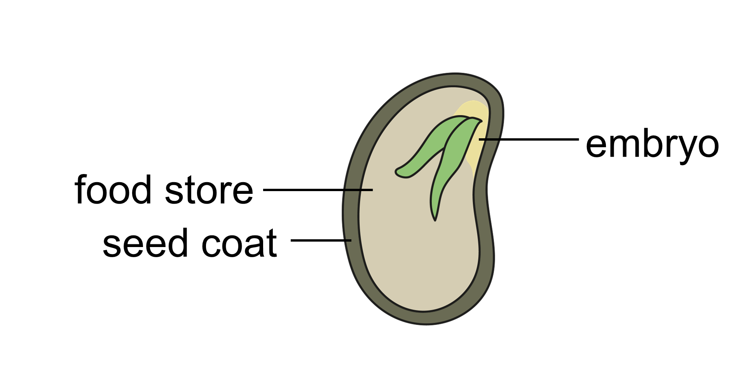
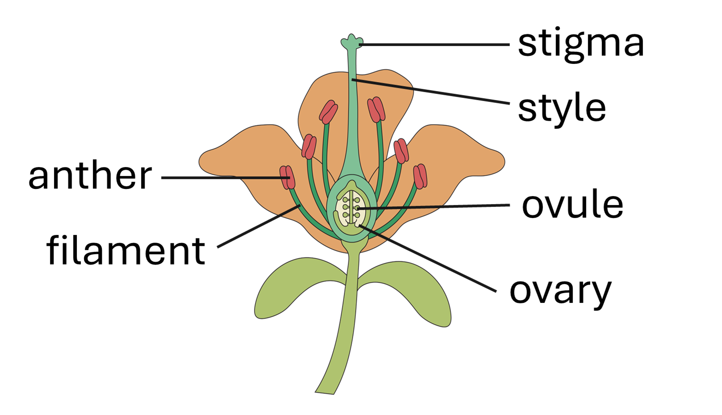
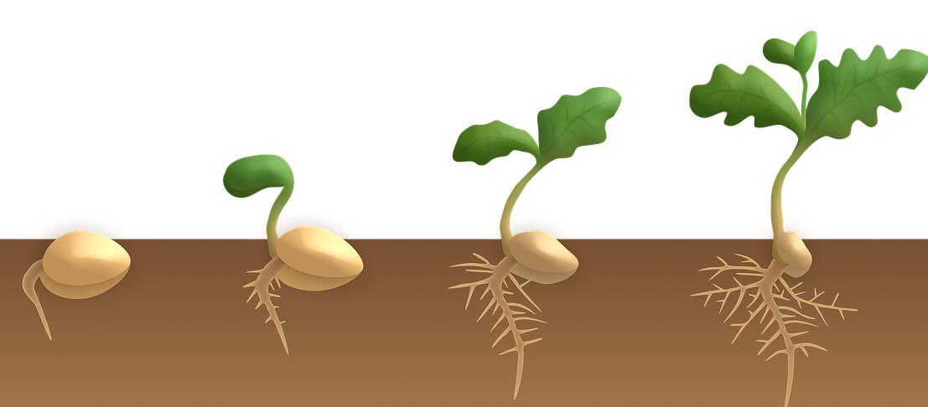
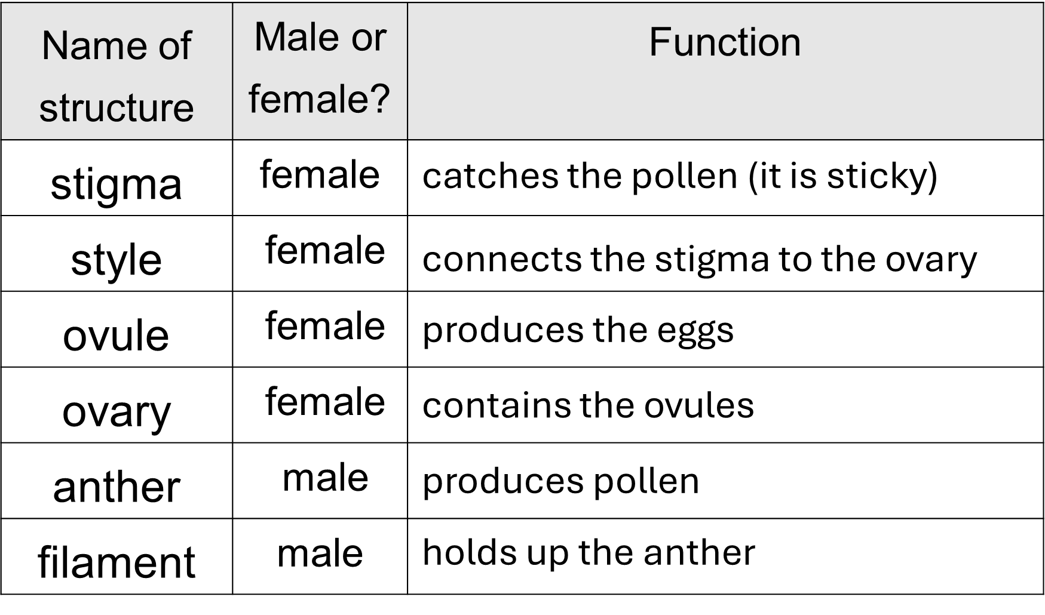
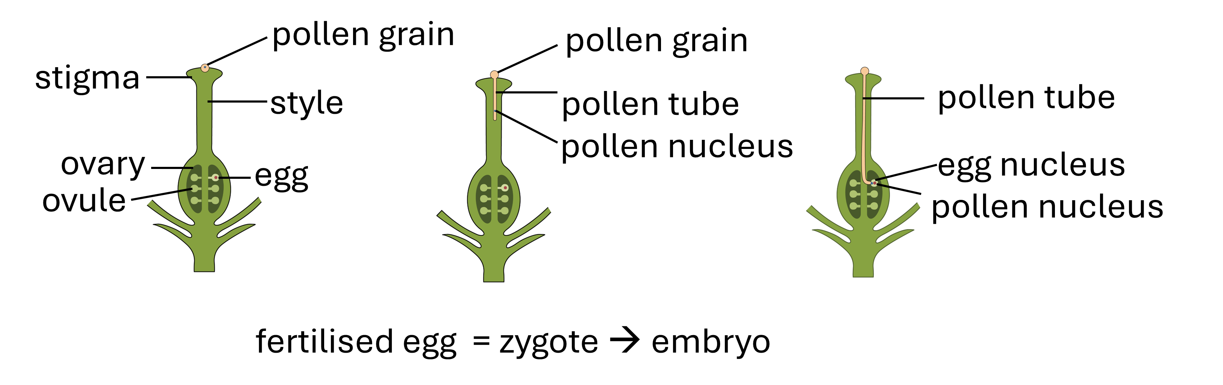
Life Cycles
Plant Reproductive System and Pollination
The ovule thickens and hardens to form the seed.
The seed coat protects the developing embryo.
The food store provides nutrients for
the developing embryo.
The ovary matures to form the fruit.
Pollen grains need to move from the anther of one flower to the stigma of another flower. This is called pollination.
Plants can be pollinated by wind or pollinators
(e.g. bees).
Germination is the development of a plant from a seed.
Water, oxygen and a suitable temperature
are needed for a seed to germinate.
During germination, the seed absorbs
water and swells, causing the hard
seed coat to split. The roots grow
downwards, and shoots start to grow upwards.
The first leaf starts to appear, and more leaves follow.
Seed Dispersal
Seeds must be dispersed from each other and from the parent to reduce competition for light, water, space and soil minerals.
Wind -Seeds are light and have a large surface area from hairs or a winged structure (e.g. dandelion, maple).
Animals - Brightly coloured and tasty fruits are eaten by animals and seeds are deposited in their waste (e.g. berries, tomato). Animals also collect and bury seeds (e.g. acorn). Seeds can also attach to the animal’s surface.
Explosion – Seeds are contained in a pod that bursts open when ripe, throwing the seeds away from the plant (e.g. pea pod).
Fertilisation and Germination in Plants
Pollen grains land on the stigma and grow a pollen tube that delivers the pollen nucleus to the egg nucleus inside the ovule.
A zygote is formed, which develops into an embryo.
Asexual Reproduction
Some plants reproduce asexually, creating identical offspring without pollination. Methods include runners, bulbs and tubers, resulting in clones that have the same genome and characteristics as the parent plant.
Unicellular organisms, like bacteria, also reproduce asexually by copying their genome before dividing into two genetically identical cells.
Sexual reproduction promotes genetic variation, enhancing adaptation and disease resistance. Asexual reproduction allows rapid population growth but lacks diversity, making populations vulnerable to environmental changes.
Science | 7.08 – Life cycles | Knowledge Organiser
Notes:
Images:
Germination (CC0) - https://pixabay.com/illustrations/germination-dicotyledon-plant-seed-3989959/
All other images – United Learning

